Slide 1
Real Time Chat Application using Signal IR 2 and MVC 5 , C#DotNet
Created By LAVKUSH MISHRA

Slide 2
Feature Of Chat Application →
Here three type of chat design →
1-Group Chat( Group Name must be same)
2-Private Chat (Friend Connection Id must be required)
4-Client Chat (Any Clients can Send message)

Slide 3
Real-time chat with Signal IR 2 and MVC 5
For this Chat Application→
1-Prerequisites
2-Set up the project
3-Run the sample
4-Examine the code
1-Prerequisites
Require Software Visual Studio 2017, or Visual Studio 2022 with the ASP.NET and web development workload.

Slide 4
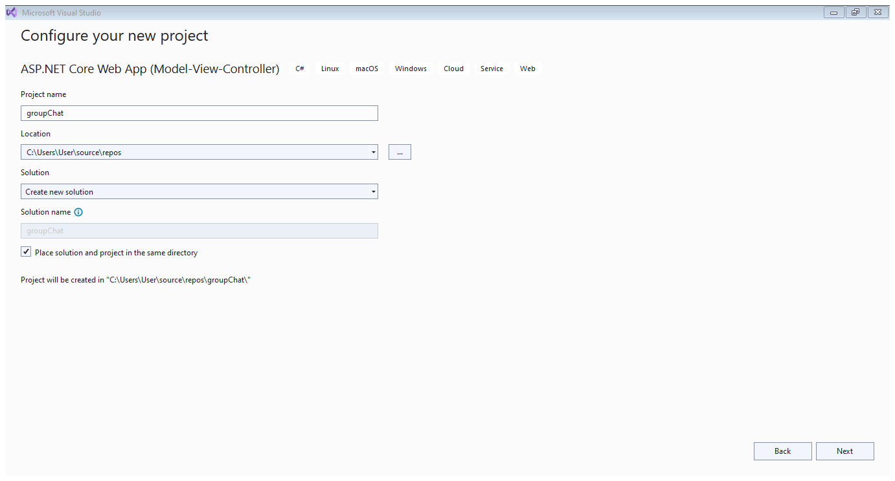
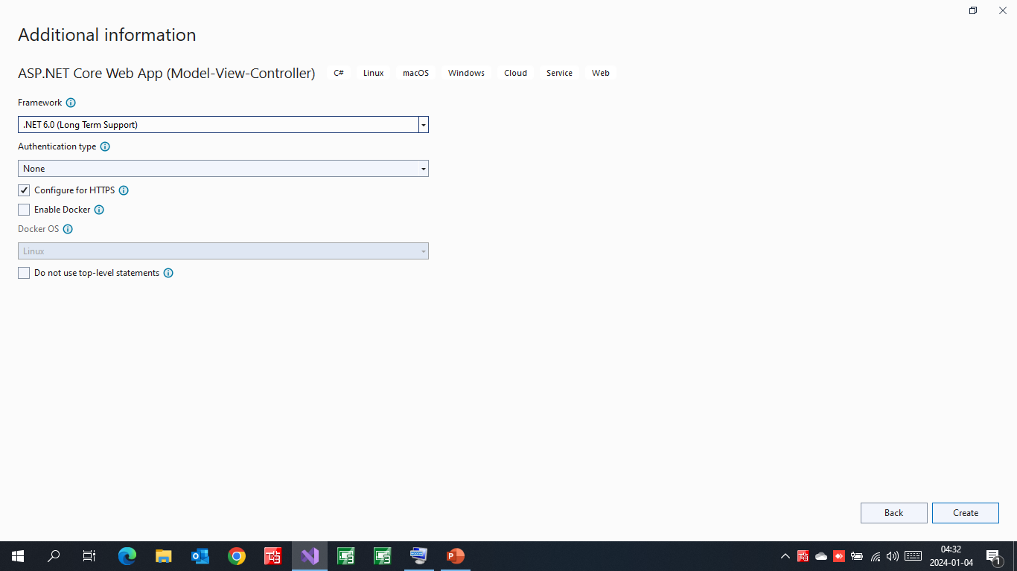
2-Set up the Project →
This section shows how to use Visual Studio 2017 and SignalR 2 to create an empty ASP.NET MVC 5 application, add the SignalR library, and create the chat application.
1-In Visual Studio, create a C# ASP.NET application that targets .NET Framework 4.5, name it groupChat,
and click Next and Click Create .
2-In New ASP.NET Web Application - groupChat, select MVC and then select Change Authentication.
3-In Change Authentication, select No Authentication and click OK.

Slide 5
2-Set up the Project →
In New ASP.NET Web Application - groupChat, select OK.
In Solution Explorer, right-click the project and select Add > New Item.
In Add New Item - groupChat, select Installed > Visual C# > Web > SignalR and then select SignalR Hub Class (v2).
Name the class ChatHub and add it to the project.
This step creates the ChatHub.cs class file and adds a set of script files and assembly references that support SignalR to the project.
Replace the code in the new ChatHub.cs class file with this code:
In Solution Explorer, right-click the project and select Add > Class.
Name the new class Startup and add it to the project.
Replace the code in the Startup.cs class file with this code:
In Solution Explorer, select Controllers > HomeController.cs.
Add this method to the HomeController.cs.
This method returns the Chat view that you create in a later step.
In Solution Explorer, right-click Views > Home, and select Add > View.
In Add View, name the new view Chat and select Add.
Replace the contents of Chat.cshtml with this code:
In Solution Explorer, expand Scripts.
Script libraries for jQuery and SignalR are visible in the project.
From the menu bar, select File > Save All.

Slide 6
Run the Sample
In the toolbar, turn on Script Debugging and then select the play button to run
When the browser opens, enter a name for your chat identity.
Copy the URL from the browser, open two other browsers, and paste the URLs into the address bars.
In each browser, enter a unique name.
Now, add a comment and select Send. Repeat that in the other browsers. The comments appear in real time.
the sample in Debug mode.

Slide 7
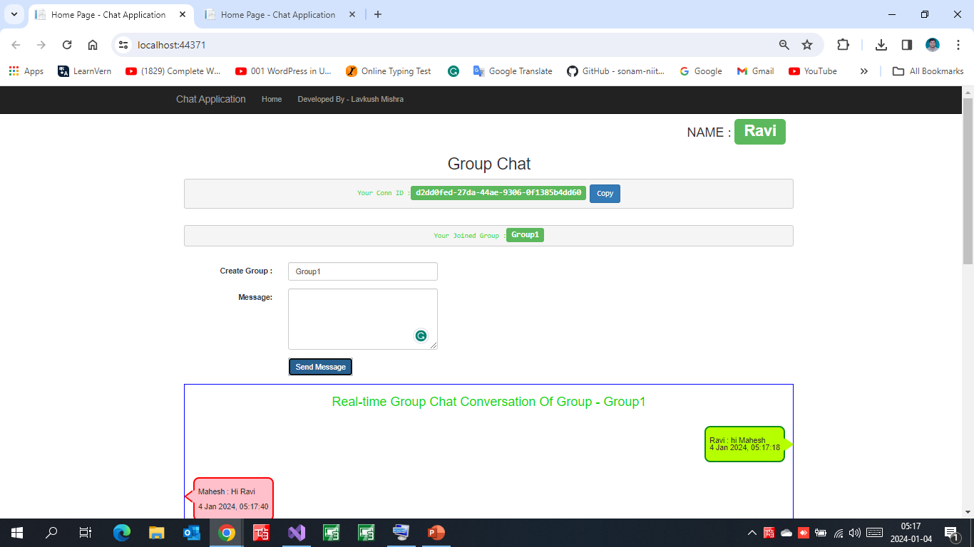
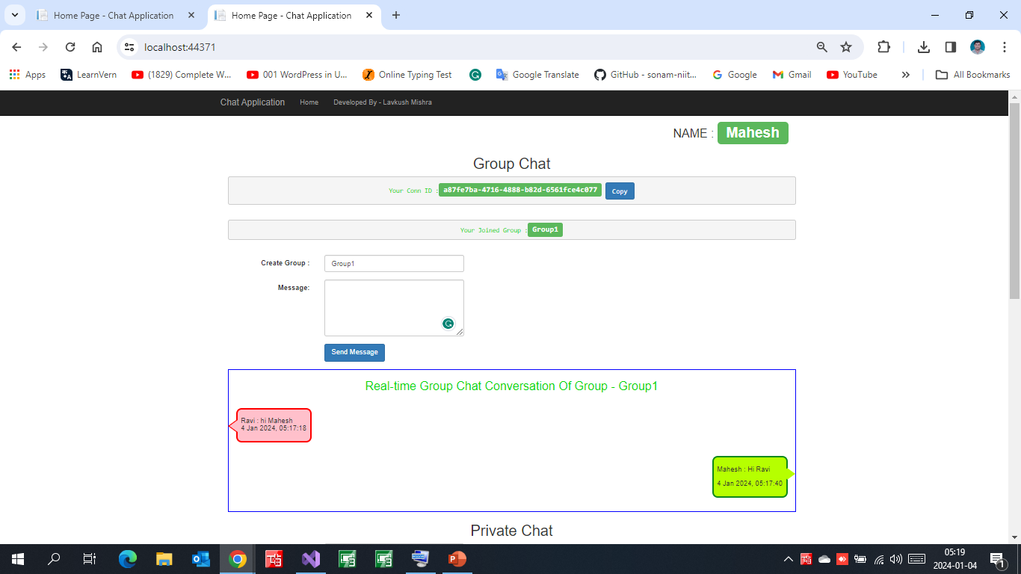
Group Chat
User 1(Ravi) [Group1]
User 2(Mahesh) [Group1]

Slide 8
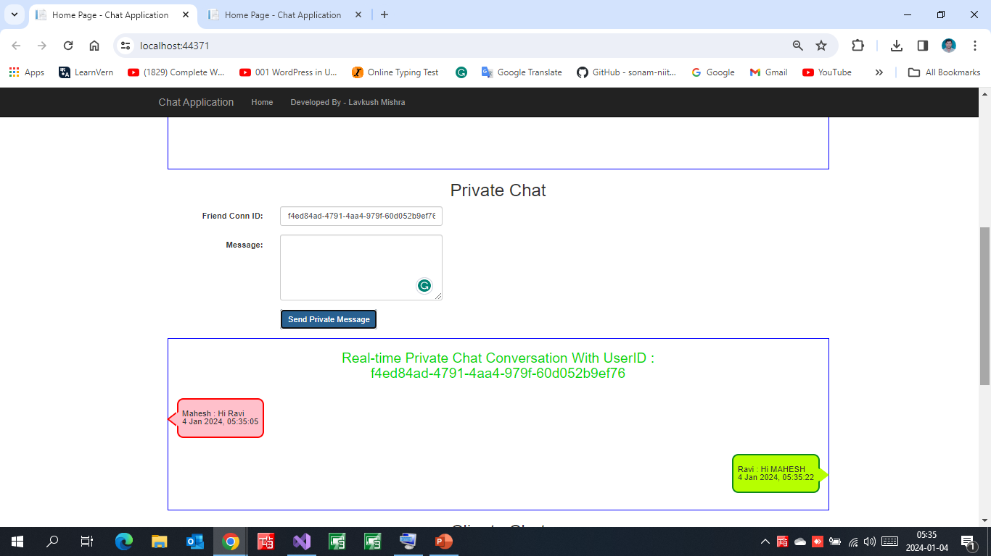
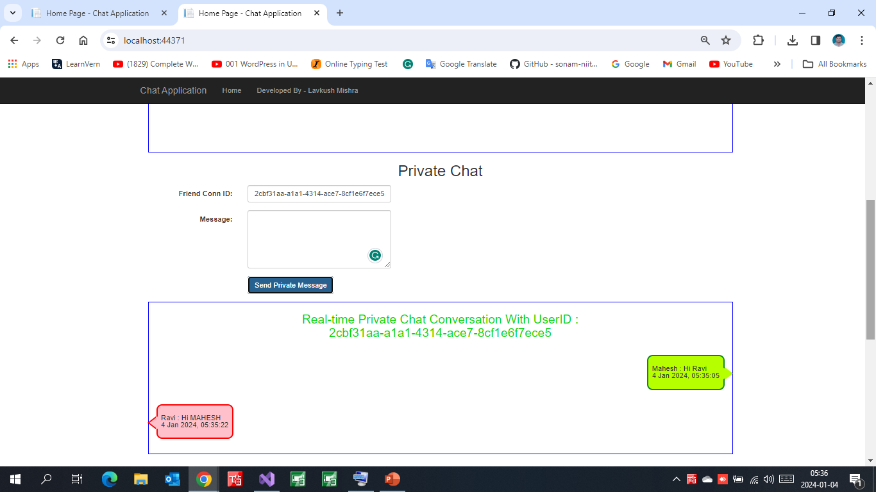
Private Chat
User 1 (Ravi)
User 2(Mahesh)
Mahesh Connection id (f4ed84ad-4791-4aa4-979f-60d052b9ef76)
Ravi Connection id (2cbf31aa-a1a1-4314-ace7-8cf1e6f7ece5)

Slide 9
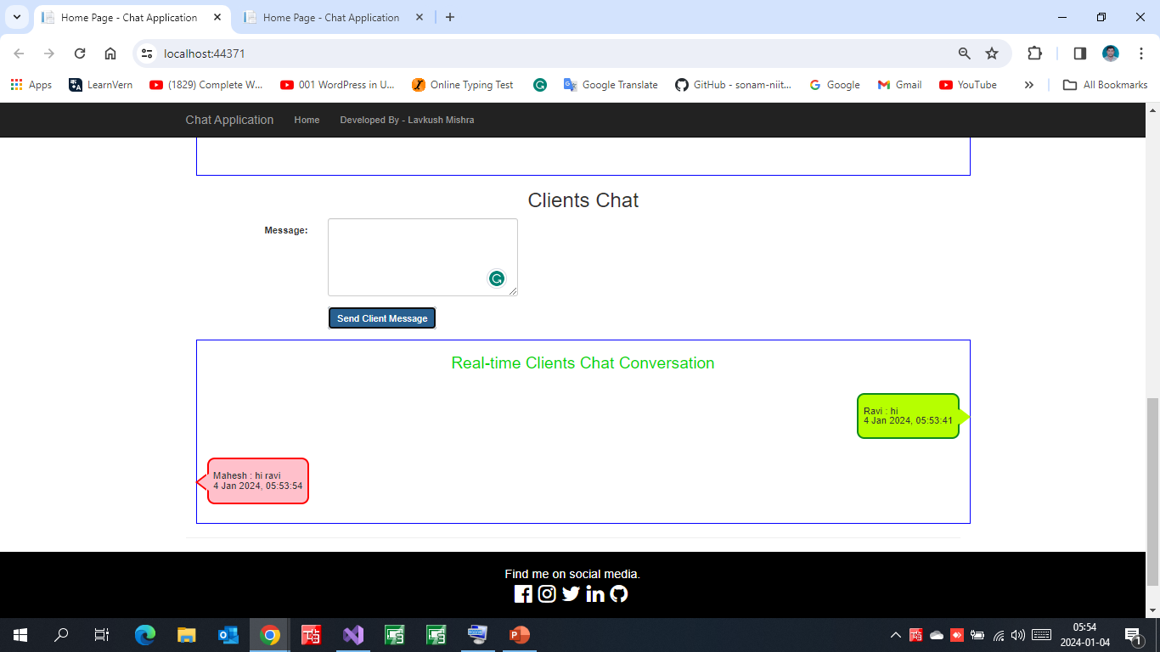
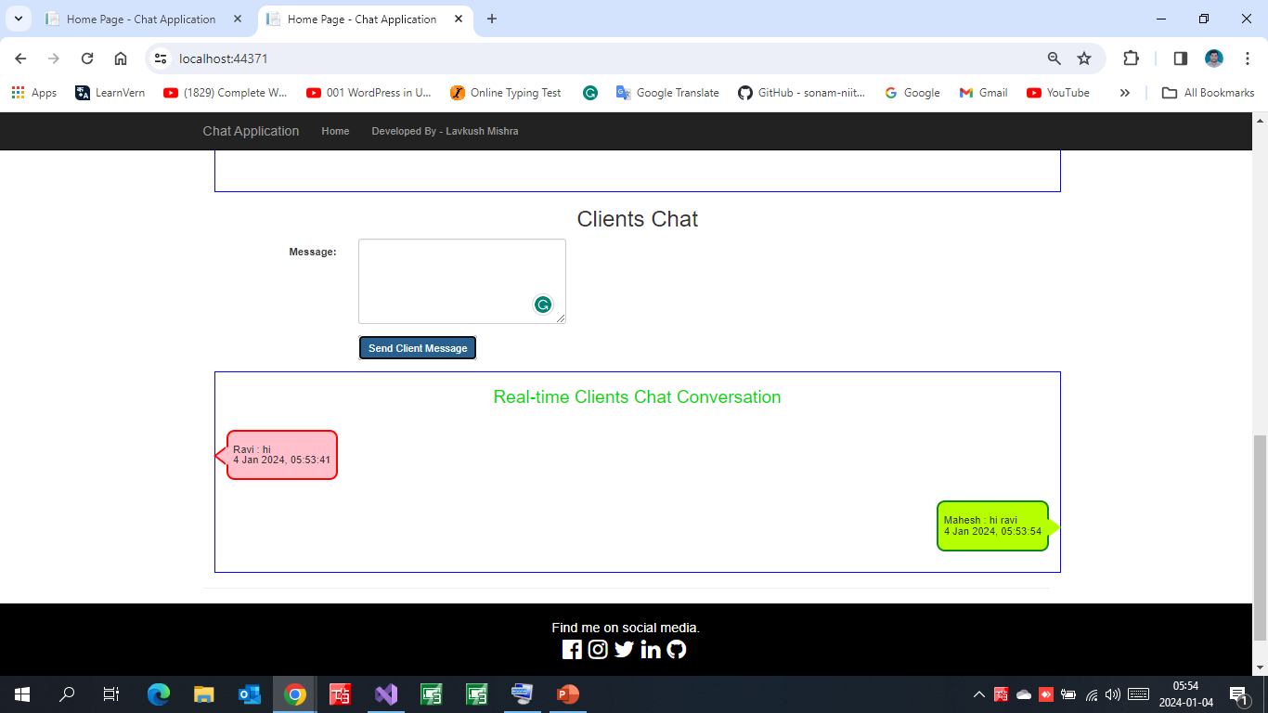
Clients Chat
Client 2
Client1

Slide 10
Thank you
The End

